Slide 1
Performance Testing
Prepared by: Adrian Bala
1 December 2016
24 November 2016

Slide 2

Performance Testing – Agenda
Introduction
Apache JMeter™ 3.0
Summary
http://media.nbcchicago.com/images/1200*676/messy-desk+2.jpg

Slide 3
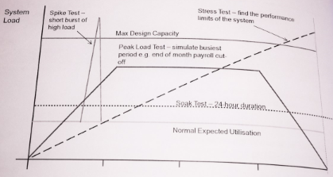
Performance Testing – Theory
Load testing
Stress testing
Endurance testing
Spike testing
Advanced Software Testing – ISTQB®

Slide 4
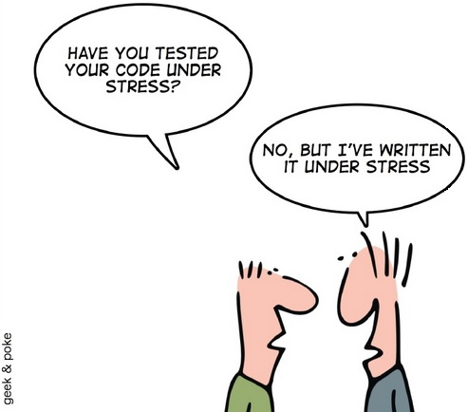
Performance Testing – Why?
Make sure it will work
To SAVE
To compare
http://www.techbrother.com/wp-content/uploads/2013/09/geek_and_poke_coders-test-s.jpeg

Slide 5





Performance Testing – Tools
The Apache JMeter™ application is open source software, a 100% pure Java application designed to load test functional behavior and measure performance.
http://jmeter.apache.org/
http://www.testwarez.pl/apache-jmeter-3-0/

Slide 6

Performance Testing – Why?
Test Plan
Thread Group
Variables – Native, User Defined
Managers – Cookie, Header
Timers – Constant, Random
Conditions – IF, WHILE
Loops – LOOP, FOREACH
Listeners – Results Tree, Summary
Requests – HTTP(S), JDBC
Assertions – Response, Size
Extractors – Regular Expressions
(…)
https://s-media-cache-ak0.pinimg.com/736x/8b/03/44/8b03446af10afd99ce1d259d26c4af76.jpg

Slide 7
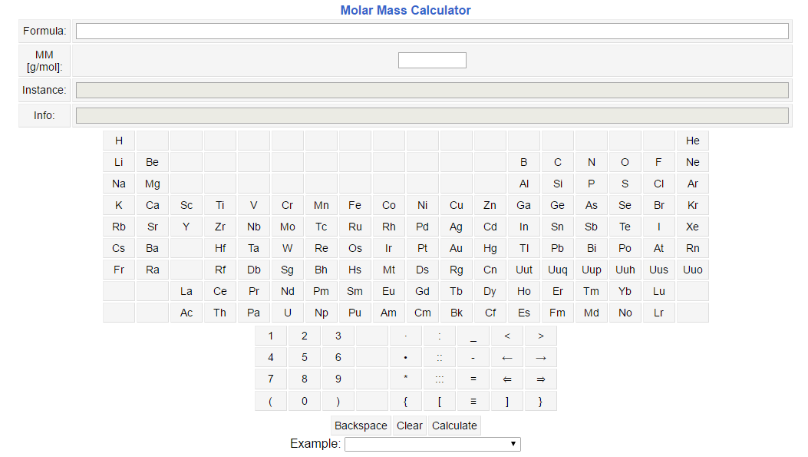
Performance Testing – Workshop
http://chem-calc.appspot.com/

Slide 8
Performance Testing – Exercises
level / exercise | E1 | E2 | E3 | E4 | E5 | Extras
basic | hello-world | multi-hello-world | multi-function-hello-world | setup-multi-function-hello-world | assert-setup-multi-function-hello-world | rec-play
medium | simple-get-post | firebase-rest-api | google-translate-api | config-google-maps-api | regression-suite | JSR223
advanced | sqlite-jdbc | stress-test | ftp-test | jms-queue | chess-game | blaze-meter
https://github.com/AdBj/tw16-jmeter-workshop

Slide 9
Performance Testing – Workshop
GET:
api/v1/get?chemform={c}
https://github.com/AdBj/tw16-jmeter-workshop/tree/master/TW16-JMeter30/A.Bala-JMeter3.0-Workshop/L2-medium/E1-simple-get-post

Slide 10
Performance Testing – Tasks
POST:
api/v1/calc
chemform={c}
https://github.com/AdBj/tw16-jmeter-workshop/tree/master/TW16-JMeter30/A.Bala-JMeter3.0-Workshop/L2-medium/E1-simple-get-post

Slide 11

Performance Testing – Stress
http://notesbyanerd.com/wp-content/uploads/2015/01/google-app-engine.png

Slide 12
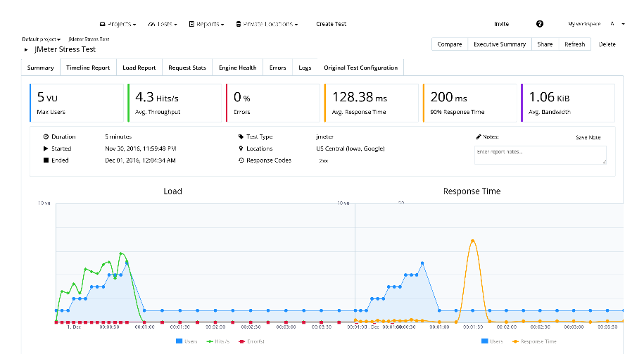
Performance Testing – Results
https://a.blazemeter.com/app/#/projects/42579/masters/15775473/summary?_k=qf2c3i

Slide 13

Performance Testing – Summary
Apache JMeter™ 3.0 qualities:
speed
portability
multithreading
usability
configurability
upgradability
automation
free
https://www.knife-depot.com/images/articles/best-pocket-knife-victorinox-swisschamp.jpg

Slide 14

Performance Testing – Homework
https://www.blazemeter.com/new_images/new_top_black_logo.svg

Slide 15
Performance Testing – References
Bayo Erinle – JMeter Cookbook
Bayo Erinle – Performance Testing with JMeter
Adam Roman – Testowanie i jakość oprogramowania. Metody, narzędzia, techniki
Adam Roman, Karolina Zmitrowicz – Testowanie oprogramowania w praktyce. Studium przypadków
Apache JMeter™ 3.0 – http://jmeter.apache.org/index.html
Custom Plugins for Apache JMeter™ 3.0 – http://jmeter-plugins.org/
GitHub API – https://developer.github.com/v3/
REST – https://www.ics.uci.edu/~fielding/pubs/dissertation/top.htm
Firebase RESTful API – https://firebase.google.com/docs/reference/rest/database/
Google Maps API – https://developers.google.com/maps/documentation/distance-matrix/
BlazeMeter – https://www.blazemeter.com/

Slide 16
Thank you!
Adrian Bala
adrian.bala@gft.com

